Slide 1
BIODIVERSITY OF PLANTS

Slide 2
Plant Classification
Plants are extremely complex and diverse, and there are millions of different plant species — some that haven’t even been fully discovered and studied yet! In order to continue the study and organization of plants, botanists (scientists who study plants) must find a way to categorize the many different species
While all plants are made up of similar parts that are essential in maintaining their survival (i.e. having roots, stem, leaves, etc.), they often look different. These differences in characteristics are used to group plants into species, which provides a way of classifying and therefore organizing plants.

Slide 3
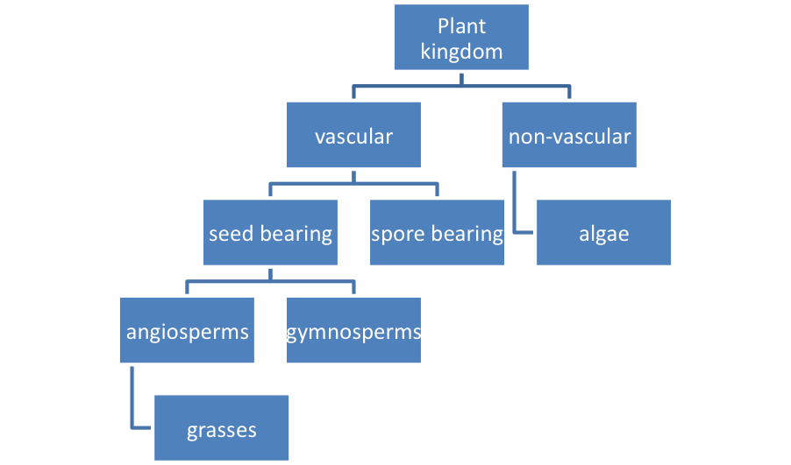
While there are many ways to structure plant classification, one way is to group them into vascular and non-vascular plants, seed bearing and spore bearing, and angiosperms and gymnosperms. Plants can also be classified as grasses, herbaceous plants, woody shrubs, and trees.
Example of Plant Classification

Slide 4
All living organisms can be divided into a few major kingdoms. The kingdoms commonly recognized include: Archaea and Bacteria (the prokaryotic kingdoms), Protista, Fungi, Plantae, and Animalia. Those organisms that carry out photosynthesis include the cyanobacteria in kingdom Bacteria, the algae in kingdom Protista, and the plants in kingdom Plantae.
Within each kingdom, the scientists have established six basic hierarchical groupings:
Phyla (or Divisions in the Plantae kingdom)
Classes
Orders
Families
Genera
Species
Each species has a scientific name which is a Latin binomial. The binomial is composed of the genus name and the specific epithet (the add-on name of the species).

Slide 5
You might wonder why we choose Latin for our binomials.
Well, Latin is a dead language; no one speaks it any longer, so its definitions do not change over time! This reduces confusion drastically. The definitions in Latin are static.
The second reason we choose Latin is that it has become universal among scientists worldwide...preventing much confusion.
In addition to official taxa, for the convenience of studying a vast array of plants, there is a division of all plants into two large groups:
Lower plants - Tallobionta
Higher - Kormobionta

Slide 6
INTRODUCTION TO ALGAE
1 - GENERAL CHARACTERISTICS
1 - Size Criterion: picoplankton (<1-2 mm), nanoplankton (2-20 mm), microplankton (> 20 mm)
2 - Most reproduce asexually
3 - Both heterotrophic and autotrophic organisms exist
4 - Increased importance of heterotrophy with reduced light and/or
nutrients
5 - Current estimates suggest that between 4,000 – 5,000 of marine
phytoplankton species have been described. Freshwater diversity is
probably higher!
6 - Phylogeny: Occupy two domains (Bacteria and Eucarya), and at least 12 phyla.

Slide 7
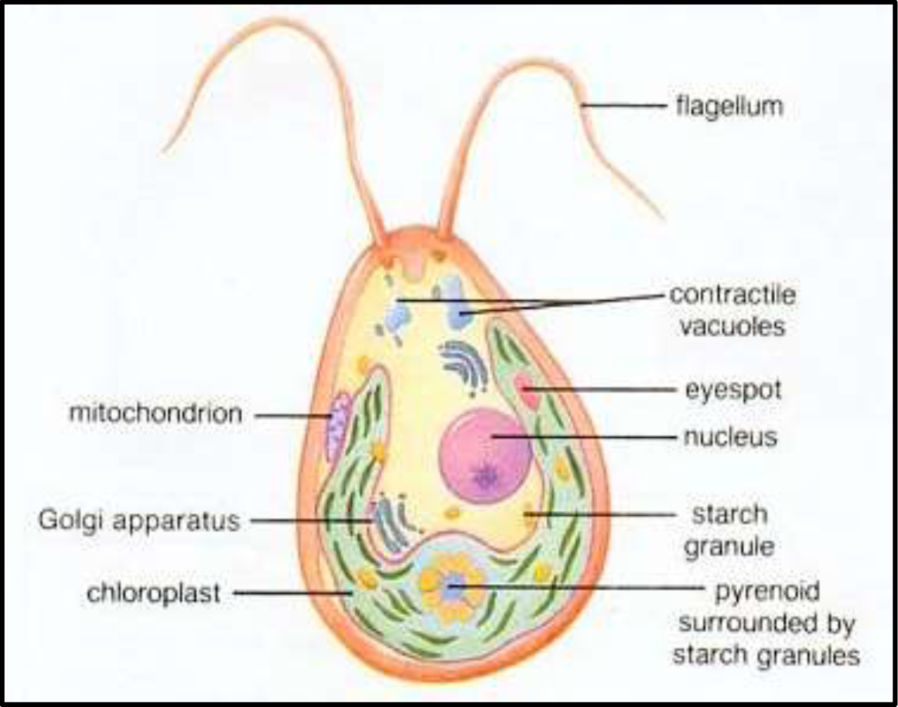
MORPHOLOGY OF AN ALGAL CELL

Slide 8
2 - ALGAL HABITAT
Algae are a group of omnipresent organisms which are present in diverse habitats such as water (aquatic algae), land (terrestrial algae), they also grow as an epiphyte, endophyte, and as well as in extreme conditions,
1 - Planktonic: ‘free-floating’.
2 - Attached:
A - Epipelic: On Sediment
B - Epiphytic: In Aquatic Vegetation (Macrophytes)
C - Epilithic: On rocks.
D - Episammic: On sand.

Slide 9
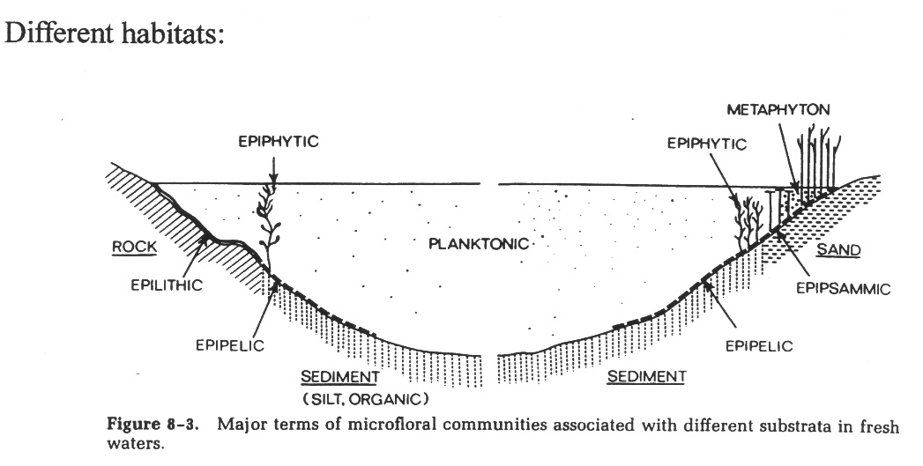
Fig. 1: Different habitat of Algal Community

Slide 10
3 - MORPHOLOGY OF ALGAE
1 - Unicellular
Unicellular algae consist of a single cell. The single cell of the body contains a chloroplast, which conducts photosynthesis to create energy from sunlight, and often contains a structure called a pyrenoid that can store energy and contractile vacuoles that help to regulate the amount of water and salts within the cell (i.e., osmoregulation), with or without flagella.
Some unicellular algae such as Chlamydomonas are motile, or able to move, using flagella.
Non-motile unicell – Chlorella.

Slide 11
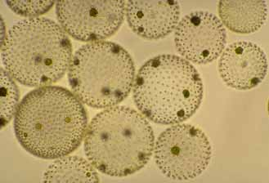
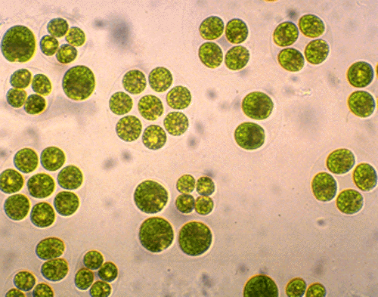
2 - Colonial
Colonial algae include different numbers of cells. Some, such as Gonium, consist of a small group of cells, whereas others, such as Volvox, consist of hundreds of cells.
Specialized colonies called coenobium contain a specific number of cells, each with their own tasks, that cannot survive alone. Like unicellular algae, many colonial algae are motile.
Fig. 3 Volvox is an example of a motile coenobium
Fig. 4 Oocystis is an example of a colonial green alga

Slide 12
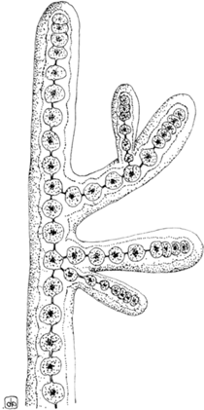
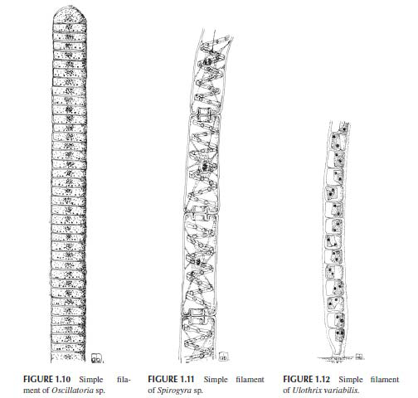
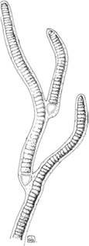
3 - Filamentous Type
Filamentous algae undergo cell division but remain connected, forming long filaments of attached cells. Each cell within the filamentous alga has its own internal structures, such as a chloroplast, and is capable of photosynthesis.
Spirogyra is one commonly-studied alga. At low tide, this stringy, green algae is exposed on rocks. Under the microscope, Spirogyra reveals a unique, spiral arrangement of chloroplasts.
Fig. 5: Multicellular thalli, with a basically uniseriate filamentous, branched, or unbranched

Slide 13
Organization, composed of multinucleate cells as a consequence of uncoupled cell division and mitosis.
Despite lacking clear physical borders, this morphotype is present in members of the class Ulvophyceae (Chlorophyta) such as Cladophora sp. and Anadyomene sp.

Slide 14
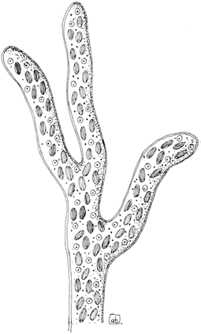
4 - Siphonous Type
Siphonous algae have a morphology that superficially resembles that of filamentous algae. However, siphonous algae consist of only one single cell with branching sections. Enteromorpha is a siphonous algae that appears similar to Spirogyra to the naked eye.
Fig. 6: Siphonous thallus of Vaucheria sessilis.

Slide 15
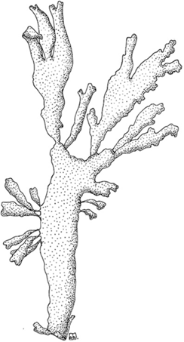
5 - Parenchymatous and Pseudo-Parenchymatous Type
Certain red algae contain boxy, plant-like cells and have a complex, multicellular structure that is termed "parenchymatous“.
Although the cells of algae do not truly differentiate to form various structures, these parenchymatous algae
often have parts that resemble leaves, stems
and roots.
Kelp grows to immense lengths, and is
perhaps one of the best-known
parenchymatous algae.
Fig. 7: Pseudo-parenchymatous
thallus of Palmaria palmata.

Slide 16
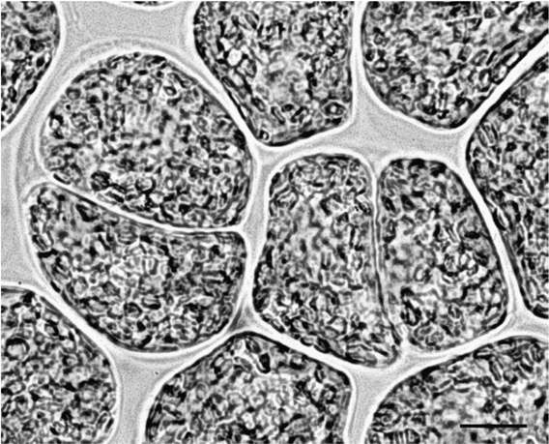
6 - Palmelloid Type
Applied to an algal colony composed of an indefinite number of non-motile cells embedded in a gelatinous or mucilaginous matrix. It may occur as a non-motile phase in a normally motile species
Fig. 8: Palmelloid phase of Euglena gracilis

Slide 17
4 - NUTRITION
Following our definition of the term algae, most algal groups should be considered photoautotrophs, that is, depending entirely on their photosynthetic apparatus for their metabolic necessities, using sunlight as the source of energy, and CO2 as the carbon source to produce carbohydrates and adenosine triphosphate.
Most algal divisions contain colorless heterotrophic species that can obtain organic carbon from the external environment, either by taking up dissolved substances (osmotrophy) or by engulfing bacteria and other cells such as particulate prey (phagotrophy).
There also exist some algae that cannot synthesize essential components such as the vitamins of the B12 complex, or fatty acids, and have to import them; these algae are defined auxotrophic.

Slide 18
On the basis of their nutritional strategies, we can classify algae into four groups:
1. Obligate heterotrophic algae: they are primarily heterotrophic, but are capable of sustaining themselves by phototropy when prey concentrations limit heterotrophic growth (e.g., Gymnodium gracilentum, Myzozoa);
2. Obligate phototrophic algae: their primary mode of nutrition is phototrophy, but they can supplement growth by phagotrophy and/or osmotrophy when light is limiting (e.g., Dinobryon divergens, Ochrophyta);
3. Facultative mixotrophic algae: they can grow equally well as photoautotrophs and as heterotrophs (e.g., Fragilidium subglobosum, Myzozoa);
4. Obligate mixotrophic algae: their primary mode of nutrition is phototrophy, but phagotrophy and/or osmotrophy provide substances essential for growth (in this group, we can include photoautoxotrophic algae) (e.g., Euglena gracilis, Euglenozoa).

Slide 19
5 - REPRODUCTION
1- Vegetative and Asexual Reproduction
A- Binary Fission or Cellular Bisection
Asexual reproduction is the production of progeny without the union of cells or nuclear material. Many small algae reproduce asexually by ordinary cell division or by fragmentation, whereas larger algae reproduce by spores.
Zoospores are flagellate, motile spores that may be produced within a parental vegetative cell as in Chlamydomonas (Chlorophyta).
Aplanospores are aflagellate spores. Their formation is similar to zoospore formation except the spores do not have flagella but have the potential to make them.
Autospores are spores which do not have the ability to make flagella i.e. aflagellate spores. Examples of autospore forming genera are Nannochloropsis (Heterokontophyta) and Chlorella (Chlorophyta).
Spores may be produced within ordinary vegetative cells or within specialized cells or structures called sporangia.

Slide 20
3. Sexual Reproduction:
All algae except the members of the class Cyanophyceae reproduce sexually. During sexual reproduction gametes fuse to form zygote (Fig. 3.18). The new genetic set up can develop by the fusion of gametes coming from the different parents.
Depending on the structure, physiological behaviour and complexity of sex organs, sexual reproductions are of the following five types:
Autogamy: In this process the fusing gametes are developed from the same mother cell and after fusion they form zygote. For the above, plant developed through autogamy does not show the introduction of any new characteristic, e.g., Diatom (Amphora normani).
Hologamy: In some unicellular member the vegetative cells of different strains (+ and -) behave as gametes and after fusion they form zygote. It is an ineffi­cient process considering the point of multiplication, but new genetic combi­nations are developed by this process, e.g., Chlamydomonas.
Isogamy: It is the process of union, between two gametes which are morphologically and physiologically similar — after fusion they form zygote. The gametes are called isogametes. Usually they are flagellate, e.g., Chlamydomonas eugametos, Ulothrix etc.

Slide 21
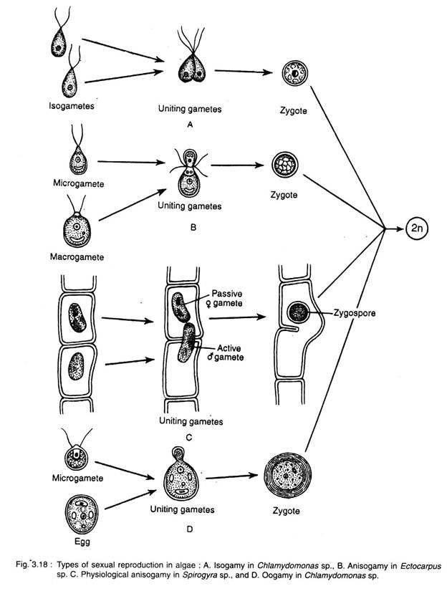
A - Isogamy
B - Anisogamy
C - Physiological Anisogamy
D - Oogamy

Slide 22
Anisogamy: In this process the uniting gametes are morphologically and physiologically different. The smaller and more active one is the microgamete (male), whereas the larger and less active one is the macrogamete (female), e.g., Chlamydomonas braunii.
Deviating from the typical anisogamy, when the uniting gametes show morphological similarity with physiological difference, it is called physiological anisogamy. e.g., Zygnema, Spirogyra etc.
Oogamy: It is an advanced process where fertilisation takes place between a small motile (nonmotile in Rhodophyceae) male gamete (sperm or antherozoides) with a large nonmotile female gamete (egg or ovum).
Male gametes develop within antheridium, whereas the female gamete within the oogonium, e.g., Oedogonium, Vaucheria, Chara, Laminaria, Sargassum, Polysiphonia, Batrachospermum etc.

